Slide 1
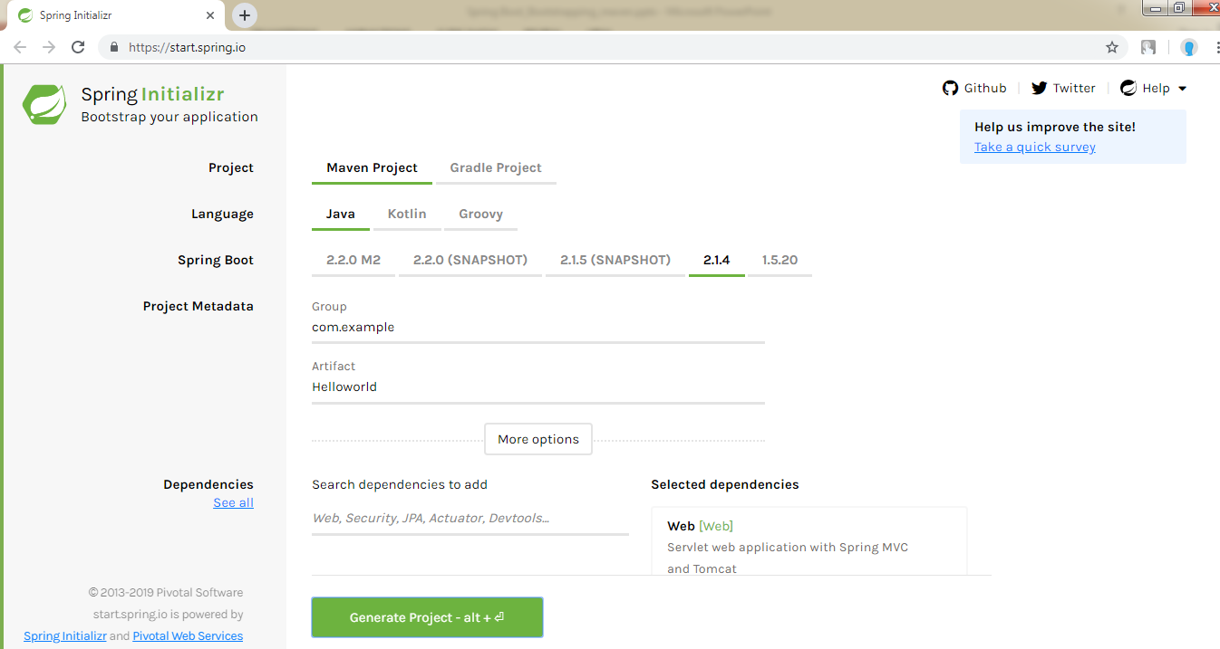
How to Bootstrapping a Spring Boot application using Spring Initializer?
One of the ways to Bootstrapping a Spring Boot application is by using Spring Initializer.
To do this, you will have to visit the Spring Initializer web page https://start.spring.io/ and choose your Build, Spring Boot Version and platform. Also, you need to provide a Group, Artifact and required dependencies to run the application.

Slide 2
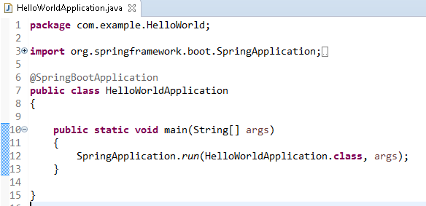
How to Bootstrapping a Spring Boot application is by using Spring Initializer?
HelloWorldApplication is the entry point of the spring boot application to start

Slide 3
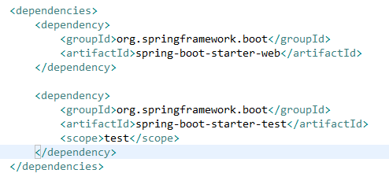
How to Bootstrapping a Spring Boot application is by using Spring Initializer?
Spring Boot provides a number of Starters to add the jars in our class path. For example, for writing a Rest Endpoint, we need to add the spring-boot-starter-web dependency in our class path.

Slide 4
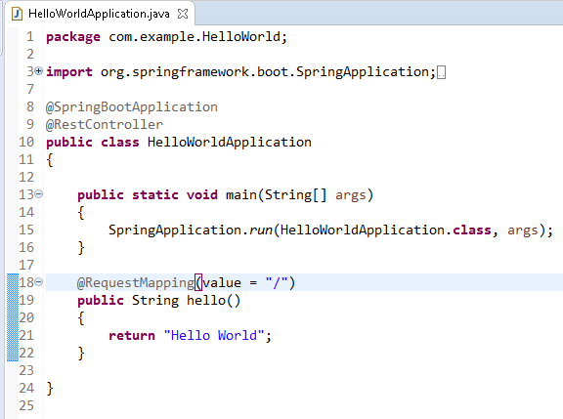
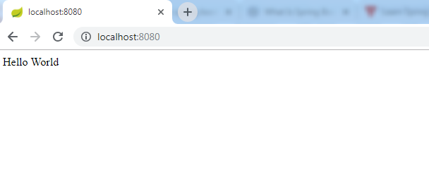
How to Bootstrapping a Spring Boot application is by using Spring Initializer?

Slide 5
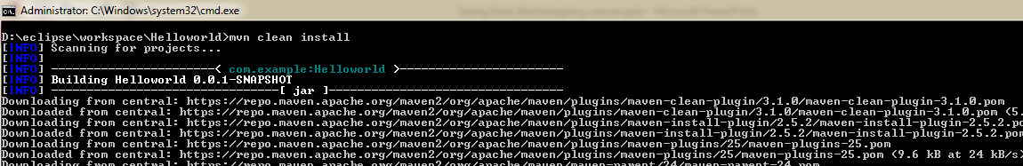
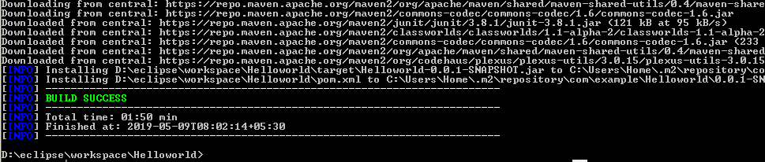
How to Bootstrapping a Spring Boot application is by using Spring Initializer?
Create an Executable JAR
mvn clean install

Slide 6
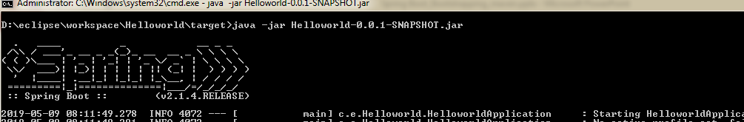
How to Bootstrapping a Spring Boot application is by using Spring Initializer?
Run Hello World with Java
java -jar Helloworld-0.0.1-SNAPSHOT.jar

